Slide 1
Using Drupal to Build Applications
Chris Porter
Acquia, Inc.
August 21, 2012
Notes:
Welcome, who am i.

Slide 2
Chris Porter Professional Services, Acquia, Inc.
3 Yrs of Professional Services @ Acquia
7 Yrs in the Drupal Community
CTR Score: 2 (yes, thats low)
Drupal.org: netw3rker
chris.porter@acquia.com

Slide 3
Application vs. website
An application processes information; a website presents information
Applications are purpose-built
Goal of application building is often intranet building, and vice-versa
Distinguishing characteristics of an application:
Tightly controlled access to information
Very structured workflow processes
Often requires integration with other systems
typically ‘behind the scenes’
Notes:
An application could deploy information to a website – for example an editorial app.

Slide 4
Overview
The Data Model
Regulating Access
Displaying the Data
Dealing with Load

Slide 5
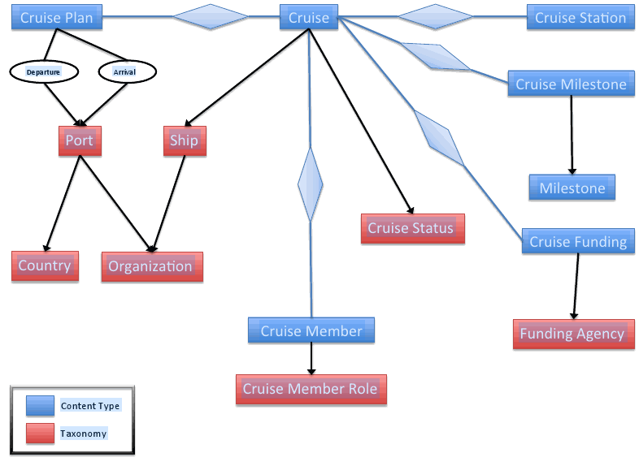
The Data Model
Overview:
Entity types
Content relationships
Entity References
Understanding views
Complex Fields
Notes:
I teach teams to view data types as content first
THE NEXT SCREEN HAS IN DEPTH INFORMATION

Slide 6
Content Types- most of the data model will consist of these Try to resist the urge to use Webform Vocabularies- used for categorizing content/data Files- static assets there are special access rules for files related to nodes
The Data Model
Entities are objects in the data model
Notes:
Everything is content, it just depends on who is accessing it and how it is presented.
Talk about the ‘contact us’ example

Slide 7
The Data Model
Entity references allow entities to be related together
Relevant modules: Entity Api (http://drupal.org/project/entity) Entity References (http://drupal.org/project/entityreference) Entity Reference Pre-populate
(http://drupal.org/project/entityreference_prepopulate) Field permissions (http://drupal.org/project/field_permissions)
Notes:
One of the most common entity references is the OG reference connecting content items to their groups.

Slide 8
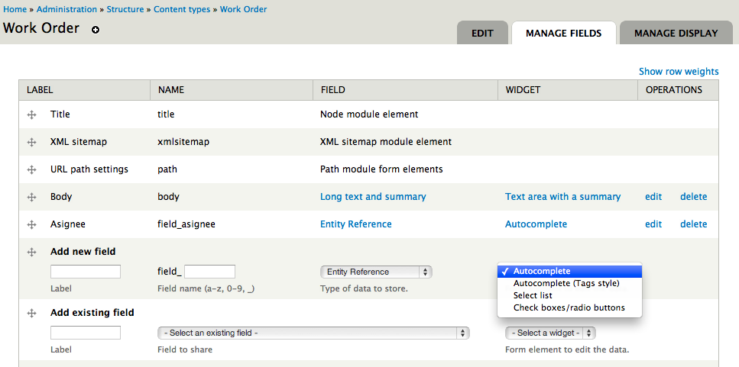
The Data Model

Slide 9
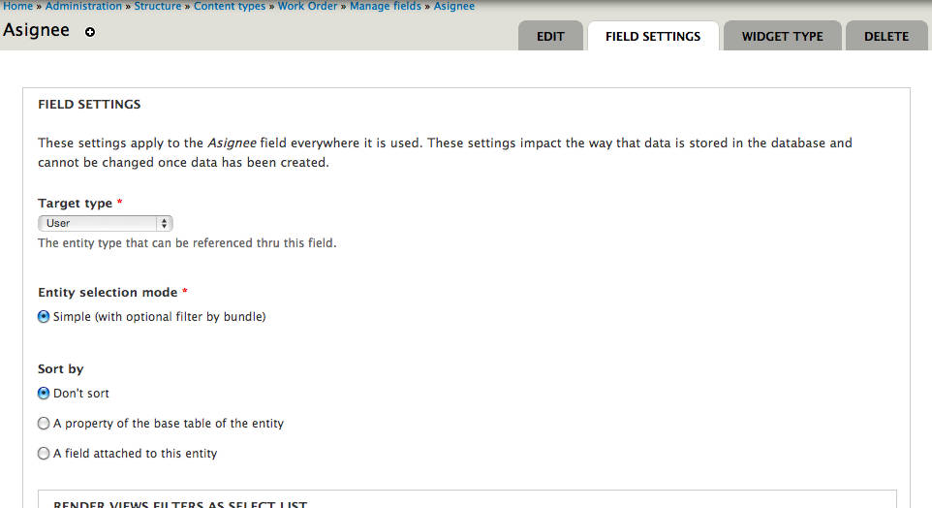
The Data Model
Notes:
WORK ORDER content type. ASIGNEE field. Targeted user

Slide 10
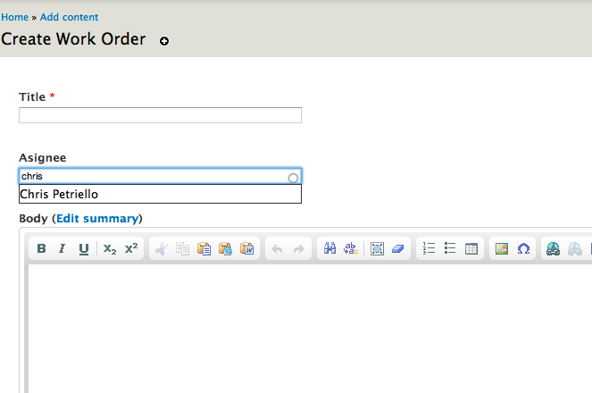
The Data Model
Notes:
What happens when you don’t want the field to be visible?

Slide 11
The Data Model
Entity relationships are exposed as views relationships
When building, always name relationships
Understand the direction of relationships
Know the difference between “-ed” and “-ing”

Slide 12
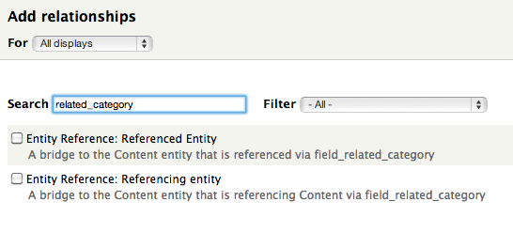
The Data Model

Slide 13
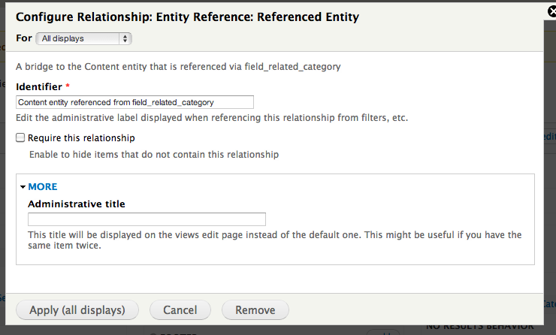
The Data Model
Notes:
MAKE SURE ADMIN TITLE IS SAME AS IDENTIFIER

Slide 14
The Data Model
Complex fields have combinations of attributes not supplied by core
Relevant modules: Field_group_multiple
Field_collections
(beware of: http://drupal.org/node/1031010)
Notes:
** how do we denote that we are in the 3rd part of section 1’s stuff?

Slide 15
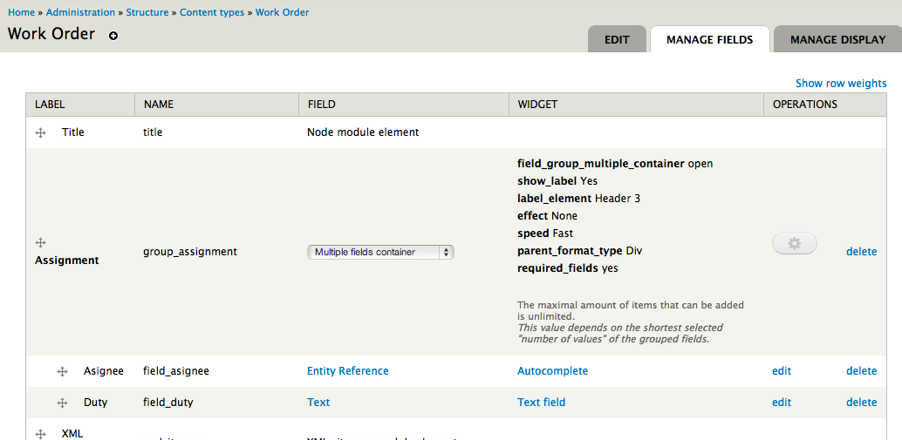
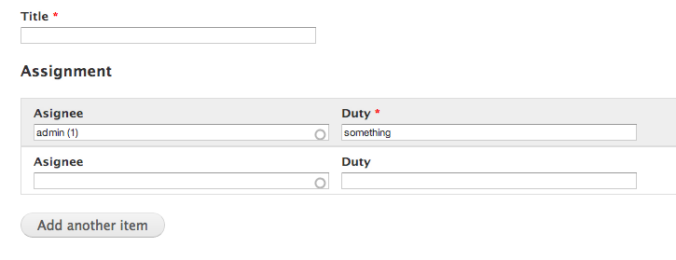
The Data Model
Field group multiple:

Slide 16
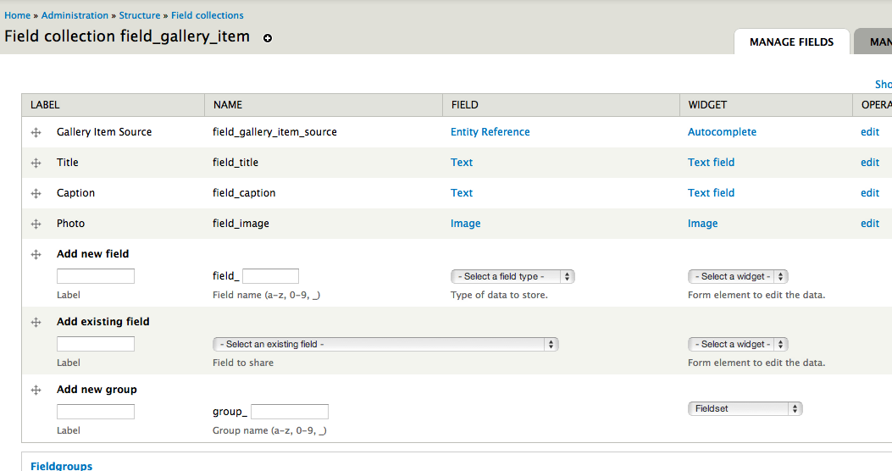
The Data Model
Field collections:

Slide 17
Regulating Access
Access control in an application can be difficult because information is typically restricted to different user groups
Overview:
Connecting with common user stores
Controlling user access to content
Organizational heirarchy
Role-based heirarchy

Slide 18
Regulating Access
An application can connect to different directories of users
Connecting with external user stores
Most common: LDAP/ Active Directory(AD)
Frequent ask: CAS
Little known: Siteminder
Other user stores

Slide 19
Regulating Access
Organizational hierarchy is the most common access regulation requirement
I recommend Organic Groups for this 99.99% of the time. TAC for other .01%
It’s confusing, but use 7.x-2.x-dev.
You will definitely need Field Permissions
If you want subgroups, use OG Subgroups (soon)

Slide 20
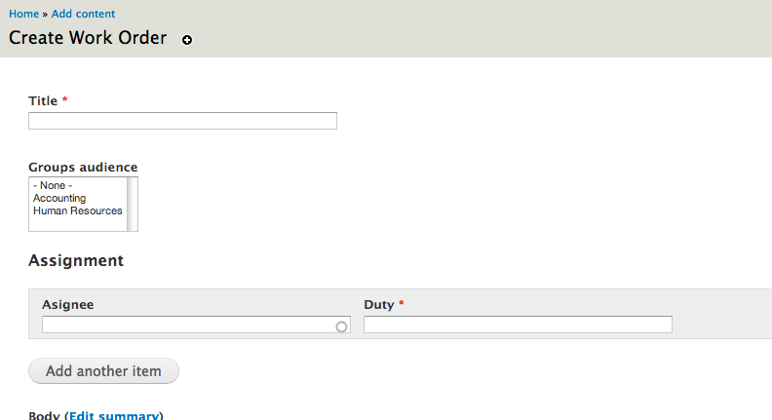
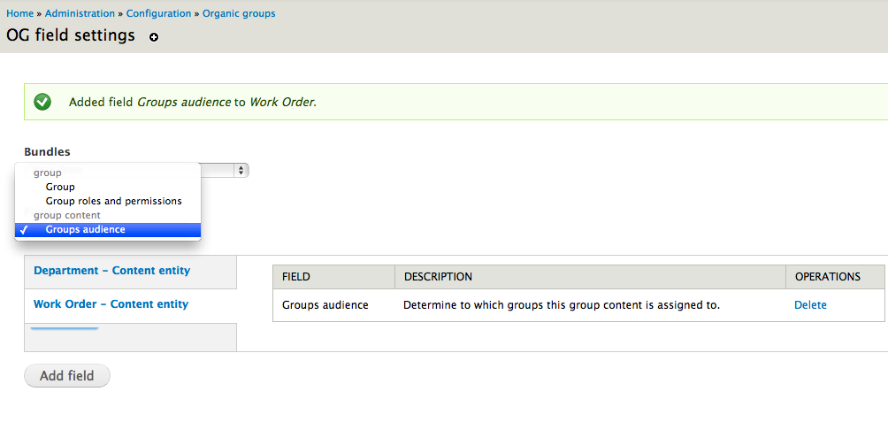
Organic groups: OG config
Regulating Access

Slide 21
Regulating Access
Taxonomy Access Control (TAC)
upside: *really* good at hierarchical access because it follows taxonomy trees
downside: administration screens can be somewhat difficult to follow, but its getting better.

Slide 22
Regulating Access
Role-based hierarchy is the second-most common access regulation requirement
Common in publishing platforms
Try Workflow module (PS: workflow for D7, you guys are awesome!)
Other assignment systems: User Access

Slide 23
Worst-Case Scenario
Regulating Access
Combining multiple systems together
Remember:
Access Granting Systems “OR” together
If you need AND, write your own, or push the “module grants” project to get a D7+ branch going.
http://drupal.org/node/791972

Slide 24
Displaying the Data
Views is a query machine with a great presentation layer.
Use the Views API when writing code. This will allow you to leverage existing - already integrated - display logic
Views are exportable through features
Watch Bevan’s presentation on views: http://denver2012.drupal.org/program/sessions/views-developers-architectural-overview

Slide 25
Displaying the Data
Use panels to combine View displays
Panels have entity relationships, make sure to exercise these
Views do not need to be blocks, enable the CTools “views content panes” module FTW
Use the “content edit” template to make better input/edit screens
Use the content view template to make better visualized screens

Slide 26
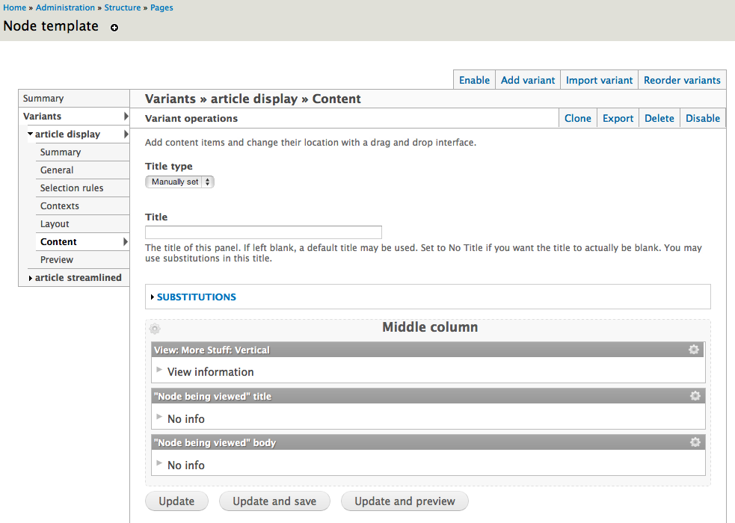
Displaying the Data

Slide 27
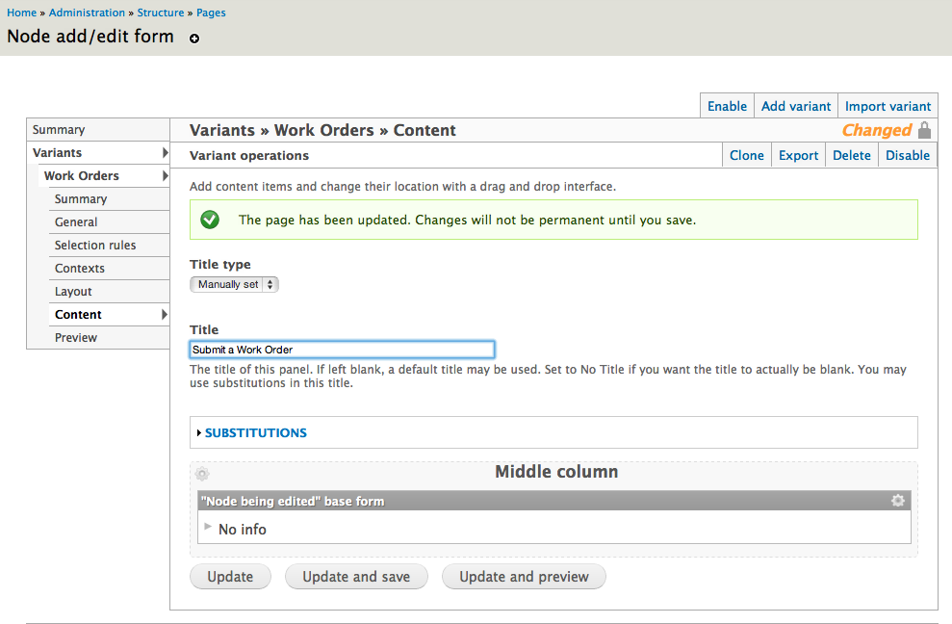
Displaying the Data
Panels can override the node add/edit form:

Slide 28
Displaying the Data
Ingredients:
1 panel
4 content types
15 fields
4 views

Slide 29
Displaying the Data
Views, Panels, and Context enable data to be displayed in meaningful ways
Views Is key (no matter what they say)
Combine elements onto a screen using Panels (no matter what they say)
Use Context to supply... context

Slide 30
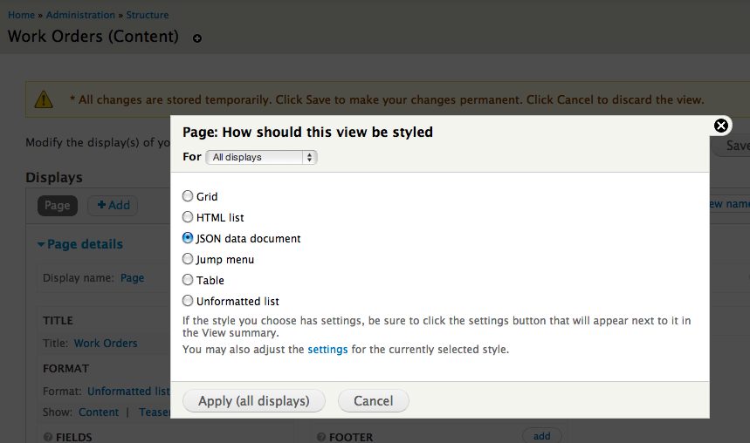
Displaying the Data
Use views to make data accessible to other systems.
Relevant modules:
Views Datasource
Services

Slide 31
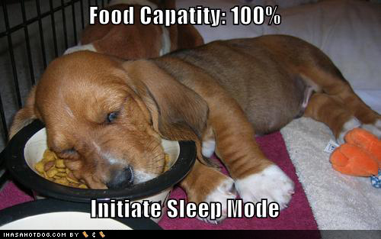
Eat Your Own Dogfood
Displaying the Data
Act as your users when building displays.
Do this *before* writing corrective code
Use rules, views_rules, and views bulk operations to add automation to the user experience

Slide 32
Scaling It all
Dealing with Load
Cache Everything
Cache that stuff
Profile, Profile, Profile

Slide 33
Caching
Dealing with Load
Use APC and Memcache.
Cache your views and panels displays as much as possible
Use drupal page caching
http://drupal.org/project/authcache/

Slide 34
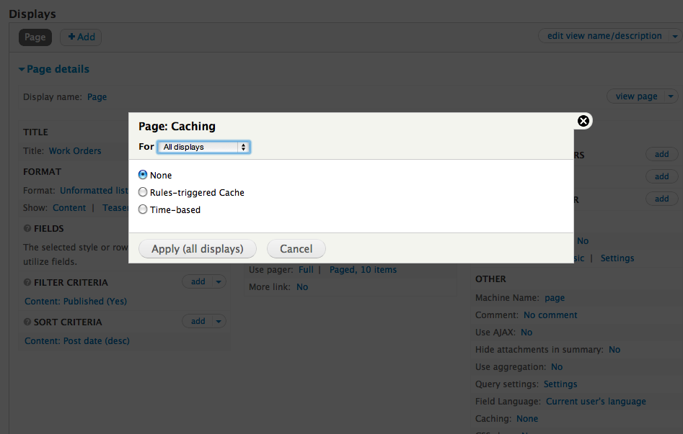
Dealing with Load
Views caching options:

Slide 35
Dealing with Load
Caching the Cache
Page level caching should be used, even if 100% authenticated traffic. Just reduce per-user customizations.
ESI’s are possible. ESI’s are panel context aware for rich customization.
They are also mostly made of magic

Slide 36
Dealing with Load

Slide 37
Profile your Application
Dealing with Load
Watch Mark Sonnabaum’s tutorials on how to use XHProf
Use XHProf
Use devel’s query reporting
Profile
Tools for profiling:
XHPROF
Devel
New Relic

Slide 38
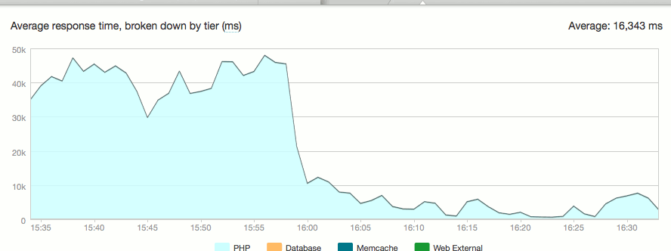
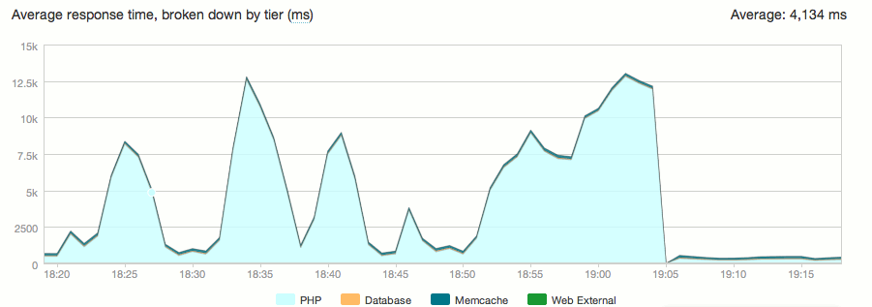
Dealing with Load
New Relic:
50s!
Real_path_cache fix
15s!
Local doc root fix
300ms

Slide 39
THINK
Think the application though.
Fix things that are broken.
Don’t write code.
Drink beer.
win!

Slide 40
Thanks!
Acknowledgements
The Drupalcon Team
Acquia, Inc.
WHOI
BioRAFT
All of my secret clients
Mark Sonnabaum
Questions?

